Slide 1
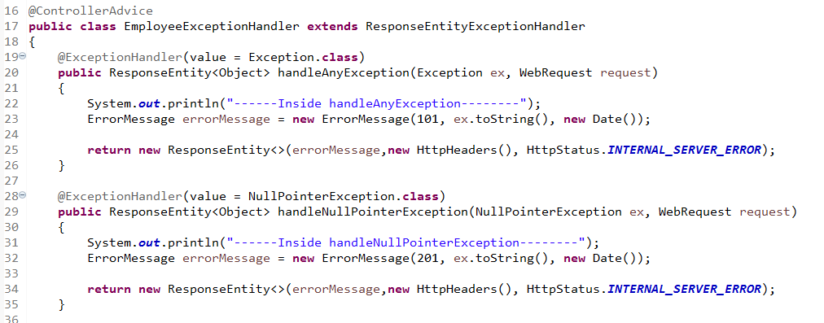
Spring Boot - Exception Handling
The @ControllerAdvice is an annotation, to handle the exceptions globally.
The @ExceptionHandler is an annotation used to handle the specific exceptions and sending the custom responses to the client.

